Slide 1
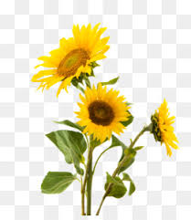

Slide 2
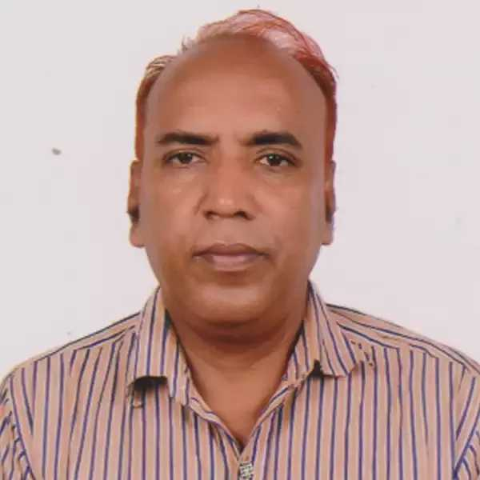
শিক্ষক পরিচিতি
পাঠ পরিচিতি
Class- Six
Subject: English 2nd Paper
UNIT: THREE
LESSON: FOUR
TOPIC: Noun and
it’s classification
মোহাম্মদ আতিকুর রহমান (ID-62)
সিনিয়র সহকারী শিক্ষক
আরজত আতরজান উচ্চ বিদ্যালয়, কিশোরগঞ্জ
atik708@gmail.com
Mob: 01715-316661

Slide 3
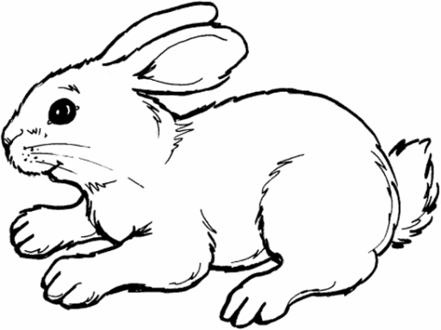
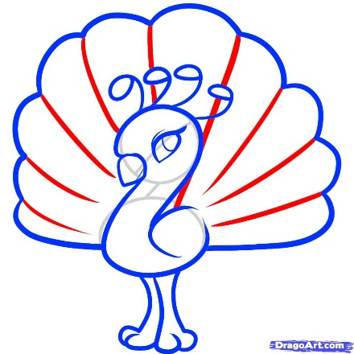
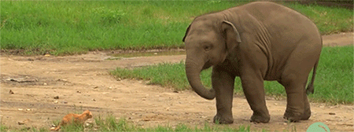
Let’s see some pictures by clicking on the following words:
Rabit
Fish
Apple
Peocock
Elephant
Do you know what kind of Parts of speech are they?

Slide 5
Learning Outcomes
Students will be able to say:
1. About the classification of Nouns.
2. They will be able to uses of Nouns.

Slide 6
Can anyone say what is noun?
Name of anything is called
Noun
Noun is also called naming word.
Noun is a word, that refers to a person, place, animal or thing.
Person
Animal
Think
Place
Rahim
Lion
Apple
Dhaka

Slide 7
KINDS OF NOUNS
Concrete Noun
Abstract Noun
Proper
Noun
Common
Noun
Collective
Noun
Material
Noun

Slide 8
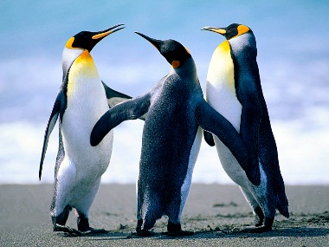
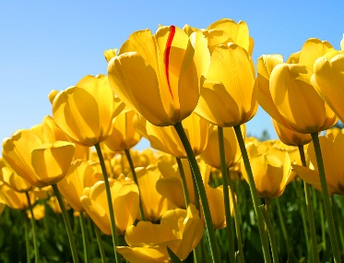
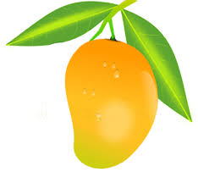
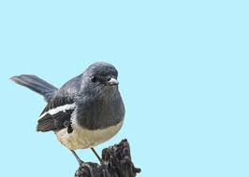
Let’s see some pictures:
Penguin
Tulip
Mango
Magpie
Do you know what kinds of noun are these?
Proper noun
Proper noun refers to a particular name of a person, place or a thing.
Dhaka is a beautiful city. It is the capital of Bangladesh.
Dhaka
Bangladesh

Slide 9
Let’s see some pictures:
Mango is sweet fruit.
Magpie is our national bird.
Do you know what kinds of noun are these?
Common noun
A Common noun is a general name for the same kind of things, persons or places.
Dhaka is a beautiful city. It is the capital of Bangladesh.
city
capital

Slide 10
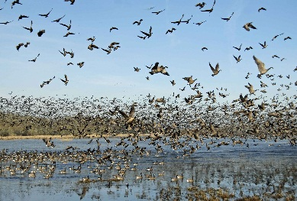
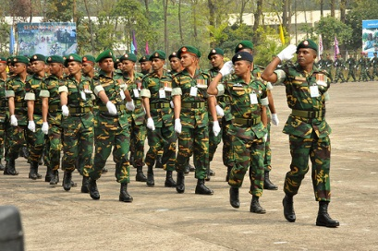
Let’s see some pictures:
A flock of birds.
An army of soldiers.
Do you know what kinds of noun are the colored words?
Collective noun
Collective noun are those words that we use to show a group of things, animals or people.
A bunch of keys. There are sixty students in this class.
bunch
class

Slide 11
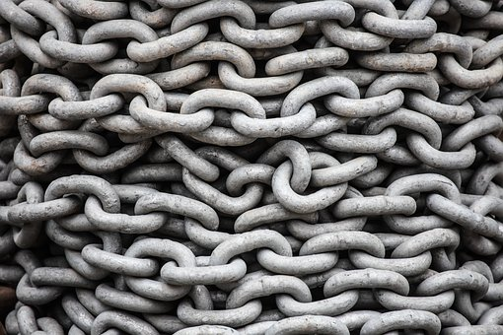
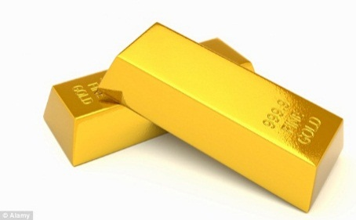
Let’s see some pictures:
This chain is made by Iron.
Gold is a precious.
Do you know what kinds of noun are the colored words?
Material noun
A material noun is the name given to a substance or matter of which things are made.
Sugar is sweet. This ring is made of silver.
Sugar
silver

Slide 12
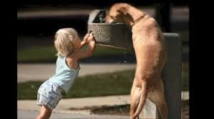
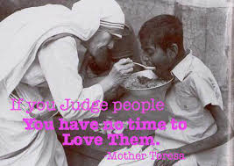
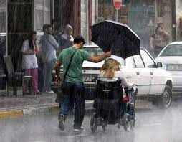
Let’s see some pictures:
Let’s discuss the above images.
Do you know what kinds of noun are these?
Abstract noun
A abstract noun is the name of a state, quality or an action of a person or name of a thing.
Honesty
Honesty is the best policy. Kindness is a great virtue. Always speak the truth.
Kindness
truth

Slide 13
GROUP WORK
Match the following parts of sentences from column A to column B.
Column A
Column B
(a) Proper Noun is the name
(b) Common Noun is the name of
(c) Collective Noun is the name of
(d) Material Noun is the name
(e) Abstract Noun is the name
(i) of quality, action, state
(ii) of a particular person, place, thing
(iii) of substance that can’t be counted
(iv) a group or collection
(v) a class

Slide 14
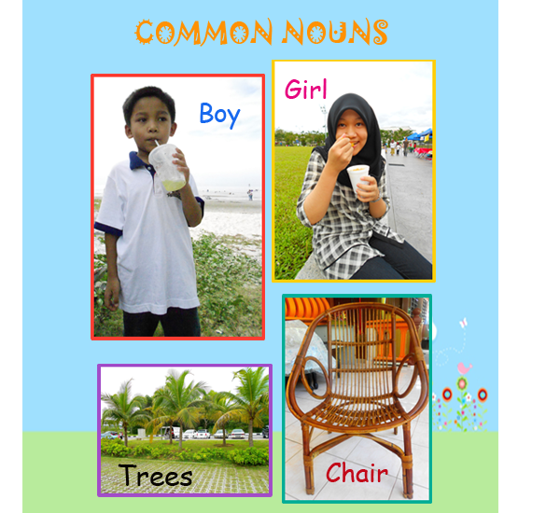
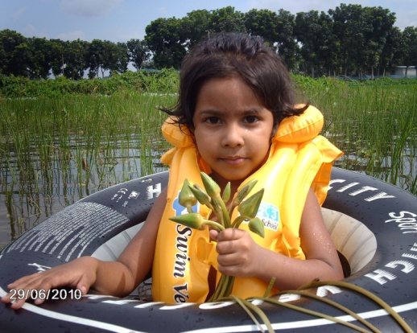
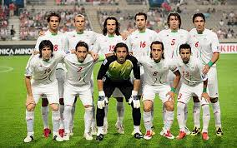
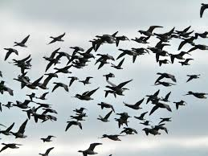
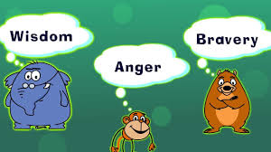
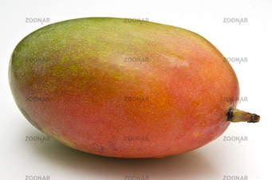
EVALUATION
What kinds of Noun are the following word/words.
A team of players.
A flock of birds
Mango
Deena

Slide 15
HOME WORK
Pic out which kinds of noun are the coloured words of the following sentences:
1. Karim joins the navy. 2. Honesty is the best policy. 3. The table is made of wood. 4. The cow is a domestic animal. 5. The Meghna is a big river. 6. Everybody wants happiness. 7. Kindness is a great virtue. 8. Tea is a popular drink. 9. Jute is a kind of fibre. 10. Narshunda is a big river.

